Slide 1

Applying SQL in Data Breach & Legal Sifter

Slide 2





Why SQL?
Automation
SQL is fast
To get rid of Human Error
Time Saving
To handle large size data

Slide 3
Tasks in SQL Server
Data Breach
Legal Sifter
Others
Export Clean Up
Notification
Load File Automation
Export Clean Up
Separation of Tags

Slide 4


Data Breach with SQL

Slide 5
1
1. Export Clean Up
Problem Identification
Automation

Slide 6

1.1 Export Clean Up
Problem Identification
Name Checking
First Name – Last Name Reverse
Middle Name in First Name
Middle Name in Last Name
Finding Similar Type of Name
Hyphen name problem
Apostrophe name problem
……
Suffix Checking
Suffix in First Name, Last Name, Middle Name
Checking the Format of Suffix corrected or not
Example: James McDonald JR (JR should be Jr)
Pivot Table Checking
1 SSN Many Name
1 Name Many DOB
Similar type of Name with Same DOB
…..
Alphanumeric Case Checking
First Name, Last Name, Middle Name shouldn’t contain any suffix
SSN, TAX ID shouldn’t contain any Alphabet
Logical Check
Address Logical
Company - Individual Logical
……

Slide 7
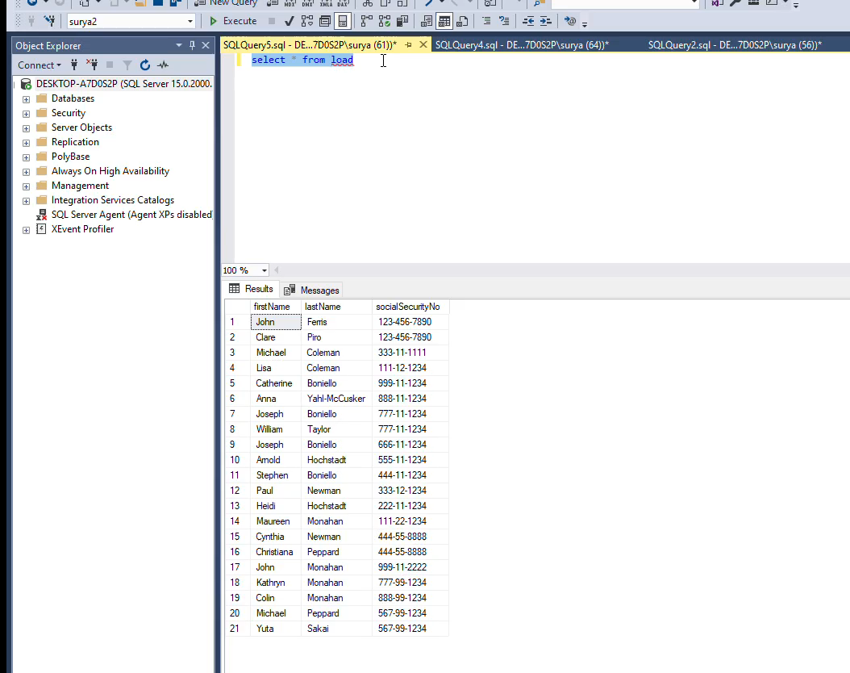

1.1 Export Clean Up
Problem Identification (Demo - Pivot)
Play the video

Slide 8
1.1 Export Clean Up
Problem Identification (Demo - Pivot)
socialSecurityNo | firstName | lastName
123-456-7890 | Clare | Piro
123-456-7890 | John | Ferris
444-55-8888 | Christiana | Peppard
444-55-8888 | Cynthia | Newman
567-99-1234 | Michael | Peppard
567-99-1234 | Yuta | Sakai
777-11-1234 | Joseph | Boniello
777-11-1234 | William | Taylor
* Please ignore the format of SSN

Slide 9

1.2 Export Clean Up
Automation
Punctuation Removing
Punctuation removing from First Name, Middle Name, Last Name, Suffix
Punctuation removing from Street Address, City
Punctuation removing from other columns
Data Formatting
Names should have a proper format.
Example: James Mcdonald should have format like James McDonald
Hcl Pvt Ltd should have format like HCL Pvt Ltd
Address should have proper format also
Phone Number format correction
……..
Data Cleaning
Trimming the Data
Cleaning the Data
Removing char(160) from the Data

Slide 10
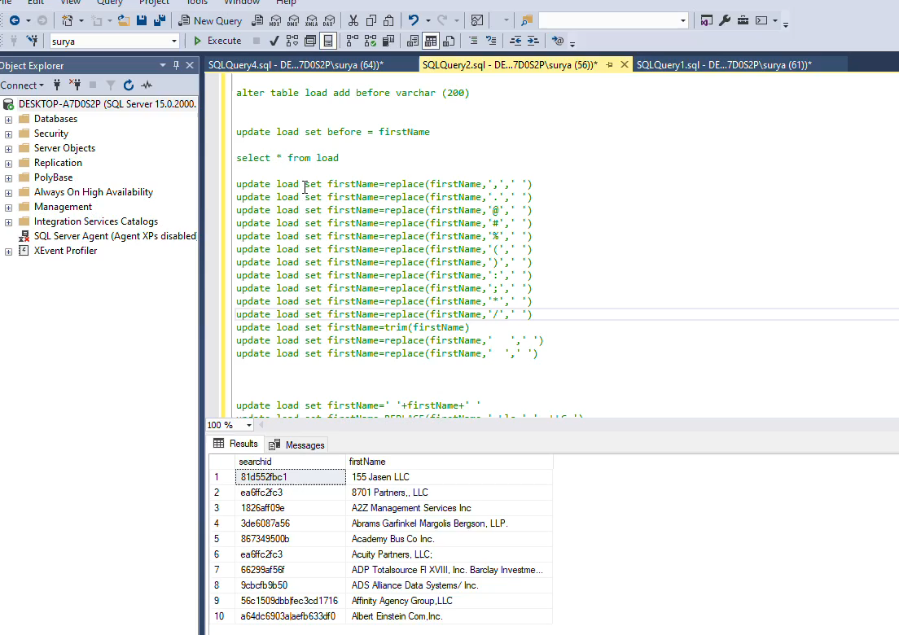
1.2 Export Clean Up
Automation (Demo - Formatting)
Play the video

Slide 11
1.2 Export Clean Up
Automation (Demo - Formatting)
BeforeFormatting | AfterFormatting
155 Jasen LLC | 155 Jasen, LLC
8701 Partners,, LLC | 8701 Partners, LLC
A2Z Management Services Inc | A2Z Management Services, Inc.
Abrams Garfinkel Margolis Bergson, LLP. | Abrams Garfinkel Margolis Bergson, LLP
Academy Bus Co Inc. | Academy Bus Co, Inc.
Acuity Partners, LLC; | Acuity Partners, LLC
ADP Totalsource Fl XVIII, Inc. Barclay Investment, Inc | ADP Totalsource Fl XVIII, Inc. Barclay Investment, Inc.
ADS Alliance Data Systems/ Inc. | ADS Alliance Data Systems, Inc.
Affinity Agency Group,LLC | Affinity Agency Group, LLC
Albert Einstein Com,Inc. | Albert Einstein Com, Inc.

Slide 12
2. Notification
2
Simple representation of Notification
FirstName | LastName | SSN | DOB | MRN
James | Potter | 123 | 07/10/1995 | 8890
Lily | Collins |  |  | 9979
John | Bonham |  |  | 1234
James | Potter | 123 |  | 9954
Lily | Collins |  |  | 8858
John | Bonham | 124 | 15/10/1994
John | Bonham |  | 20/11/1994
John | Bonham |  | 15/10/1994 | 1234
James | Potter |  | 07/10/1995
Same Entity
Same Entity
Same Entity

Slide 13

2. Notification
How SQL solved this problem?
Number of scenario increases with identifiers. Things get complicated with number of entries and number of identifiers.
SQL finds the relationship between entities based on the identifiers and decides similar entities.
Strong Relationship
1:1
Row (i)
i=1,2,…
Row (j)
j=1,2,…
Weak Relationship
1:m
m:1
m:m

Slide 14
2. Notification
Creating an algorithm to understand the same tuple
FirstName | LastName | SSN | DOB | MRN
James | Potter | 123 | 07/10/1995 | 8890
Lily | Collins |  |  | 9979
John | Bonham |  |  | 1234
James | Potter | 123 |  | 9954
Lily | Collins |  |  | 8858
John | Bonham | 124 | 15/10/1994
John | Bonham |  | 20/11/1994
John | Bonham |  | 15/10/1994 | 1234
James | Potter |  | 07/10/1995
Relationship :
1:m
Relationship :
1:1 (Strong - Strong)
Relationship :
1:1 (Strong – Weak)
Transitive Relationship

Slide 15
2.1 Notification
Identification
Related Tuples
Unrelated Tuples
Case 1:
First related tuple connected with strong identifier (SSN). Those tuples should be same
For the second related tuple , θ_{(i)} (SSN) -> θ _{(i)} (DOB) and θ _{(i)} (DOB) = θ _{(j)} (DOB) and θ _{(j)} (other strong identifier = NULL)
Therefore, θ_{(i) =} θ_{(j)}
FirstName | LastName | SSN | DOB | MRN
James | Potter | 123 | 07/10/1995 | 8890
Lily | Collins |  |  | 9979
John | Bonham |  |  | 1234
James | Potter | 123 |  | 9954
Lily | Collins |  |  | 8858
John | Bonham | 124 | 15/10/1994
John | Bonham |  | 20/11/1994
John | Bonham |  | 15/10/1994 | 1234
James | Potter |  | 07/10/1995
FirstName | LastName | SSN | DOB | MRN
James | Potter | 123 | 07/10/1995 | 8890
Lily | Collins |  |  | 9979
John | Bonham |  |  | 1234
James | Potter | 123 |  | 9954
Lily | Collins |  |  | 8858
John | Bonham | 124 | 15/10/1994
John | Bonham |  | 20/11/1994
John | Bonham |  | 15/10/1994 | 1234
James | Potter |  | 07/10/1995

Slide 16
2.1 Notification
Identification
Related Tuples
Unrelated Tuples
Case 2:
Tuples connected with only weak identifiers. θ _{(i)} (strong identifier = NULL) and θ _{(j)} (strong identifier = NULL)
One Name may have many MRN. It’s one to many relationship (1:m)
FirstName | LastName | SSN | DOB | MRN
James | Potter | 123 | 07/10/1995 | 8890
Lily | Collins |  |  | 9979
John | Bonham |  |  | 1234
James | Potter | 123 |  | 9954
Lily | Collins |  |  | 8858
John | Bonham | 124 | 15/10/1994
John | Bonham |  | 20/11/1994
John | Bonham |  | 15/10/1994 | 1234
James | Potter |  | 07/10/1995
FirstName | LastName | SSN | DOB | MRN
James | Potter | 123 | 07/10/1995 | 8890
Lily | Collins |  |  | 9979
John | Bonham |  |  | 1234
James | Potter | 123 |  | 9954
Lily | Collins |  |  | 8858
John | Bonham | 124 | 15/10/1994
John | Bonham |  | 20/11/1994
John | Bonham |  | 15/10/1994 | 1234
James | Potter |  | 07/10/1995

Slide 17
2.1 Notification
Identification
Related Tuples
Unrelated Tuples
Case 3:
It’s a Transitive Relationship.
θ_{(i)} (Name) = θ _{(j)} (Name) = θ _{(k)} (Name) and θ_{(i)} (SSN) -> θ _{(i)} (DOB) and θ _{(i)} (DOB) = θ _{(j)} (DOB) and θ_{(j)} (DOB) -> θ _{(j)} (MRN) and θ _{(j)} (MRN) = θ _{(k)} (MRN) and θ _{(k)} (other strong identifier = NULL)
Therefore, θ_{(i) =} θ_{(j) =} θ_{(k)}
FirstName | LastName | SSN | DOB | MRN
James | Potter | 123 | 07/10/1995 | 8890
Lily | Collins |  |  | 9979
John | Bonham |  |  | 1234
James | Potter | 123 |  | 9954
Lily | Collins |  |  | 8858
John | Bonham | 124 | 15/10/1994
John | Bonham |  | 20/11/1994
John | Bonham |  | 15/10/1994 | 1234
James | Potter |  | 07/10/1995
FirstName | LastName | SSN | DOB | MRN
James | Potter | 123 | 07/10/1995 | 8890
Lily | Collins |  |  | 9979
John | Bonham |  |  | 1234
James | Potter | 123 |  | 9954
Lily | Collins |  |  | 8858
John | Bonham | 124 | 15/10/1994
John | Bonham |  | 20/11/1994
John | Bonham |  | 15/10/1994 | 1234
James | Potter |  | 07/10/1995

Slide 18
2. Notification
Creating another algorithm to merge similar tuple
FirstName | LastName | SSN | DOB | MRN
James | Potter | 123 | 07/10/1995 | 8890 | 9954
John | Bonham | 124 | 15/10/1994 | 1234
John | Bonham |  | 20/11/1994
Lily | Collins |  |  | 9979 | 8858

Slide 19
3
3. Load File Automation
Part of CRA Project

Slide 20
Legal Sifter with SQL

Slide 21
4
4. Export Clean Up
Problem Identification
Automation

Slide 22
4.1 Export Clean Up
Problem Identification
Logical Tests
1.
Start Date shouldn't be after End Date
3.
If End Date is blank
then Shifting Status should be "Ignore“
5.
If End Date is blank or N/A
then Term Type shouldn't be "Fixed" or related
to Fixed
2.
If End Date is 'N/A'
then [(2a) Term Type] should be "Evergreen or Silent / Conditional End Date"
4.
If End Date is blank
then Shifting Status shouldn't be "Completed“
6. (Long_Col)
If Term Type is "Fixed" or "Evergreen or Silent/ Conditional End Date"
then Long_Col should be "Silent"

Slide 23
4.1 Export Clean Up
Problem Identification
Logical Tests
7. ( Long_Col)
If "Term Type" is "Fixed w/ Auto-Renewal" or
"Fixed w/ Option to Renew"
then Long_Col shouldn't be "Silent" or "Unsure"
9.
if "Termination for Convenience" is not "silent" or
not "Unsure"
then "Termination for Convenience Notice (Days)" shouldn't be "Silent"
8.
if "Termination for Convenience" is "Silent" or "Unsure"
then "Termination for Convenience Notice" should be Silent
10.
identify those dates where month and date is same for both Start Date and End Date

Slide 24
4.1 Export Clean Up
Problem Identification
Logical Tests
11.
Identify wrong spelling words from:
[(3) Prod/Serve Description]
[(3) Contract Title]
13.
Identify unrealistic date e.g. 31st April
15.
If Counter Party Name is not blank then Counter
Party Type shouldn't be blank or vice versa
12.
Identify Similar Type of Names from:
[(3) Prod/Serve Description]
[(3) Contract Title]
14.
Counter Party Type should be according to Counter Party Name

Slide 25
4.1 Export Clean Up
Problem Identification
Logical Tests
16.
Creating Frequency Diagram for
["(1) Highmark Paper?"],
["(3) Highmark Legal Entity"] and other Columns
to identify the Outliers
18.
If Payment Term="Other"
then Other Payment Term shouldn't be blank
If Payment Term<>"Other"
then Other Payment Term should be blank
17.
If [Hightmark Legal Entity] is "Others"
then [(3) Highmark Legal Entity - Other] shouldn't be blank
19.
Finding the partial address

Slide 26
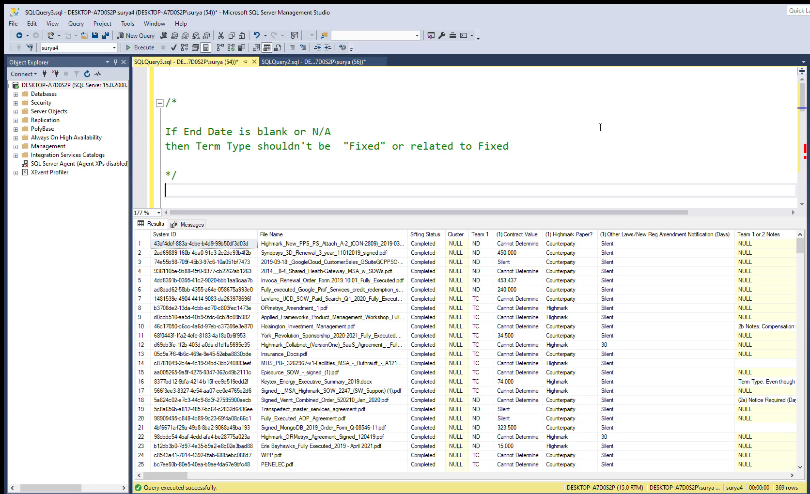
4.1 Export Clean Up
Problem Identification (Demo – Logical Test)
Play the video

Slide 27
4.2 Export Clean Up
Automation
Punctuation Removing
Punctuation removing from Contract Title, Counter Party Name, Prod/Serve Description etc
Punctuation removing from Address
Punctuation removing from other columns
Data Formatting
Name Formatting in Contract Title, Counter Party Name, Prod/Serve Description etc
Name Consistency
Address Formatting
Address Consistency
Amount Formatting in Contract Value, General Liability Ins: Ctpy Single Limit, etc.
Data Cleaning
Trimming the Data
Cleaning the Data
Removing char(160) from the Data

Slide 28
Separation of Tags with SQL

Slide 29
4. Separation of Tags
5
DATA
GF ID | Tags
BO99InMB_bRK9L7nntns | LO2 REVIEWED; non-responsive; LO2 PROD 2
Cu99InMB_bRK9L7nntns | LO2 REVIEWED; LO2 PROD 2; LO2 QC
JO99InMB_bRK9L7nntns | LO2 REVIEWED; non-responsive; LO2 PROD 2
OUTPUT
GF ID | LO2 REVIEWED | non-responsive | LO2 PROD 2 | LO2 QC
BO99InMB_bRK9L7nntns | LO2 REVIEWED | non-responsive | LO2 PROD 2
Cu99InMB_bRK9L7nntns | LO2 REVIEWED |  | LO2 PROD 2 | LO2 QC
JO99InMB_bRK9L7nntns | LO2 REVIEWED | non-responsive | LO2 PROD 2

Slide 30
4. Separation of Tags
Automation Process in Python / SQL
Importing Dataset
Creating Data Frame in PANDAS
Tokenize the Tags
Merging all the Tags
Removing Duplicate Tags
Creating Columns for each Unique Tags
Getting the output by running code
Export

Slide 31



4. Separation of Tags
Importing
Importing
Creating Queries for SQL Server
Exporting

Slide 32
THANK YOU

